Slide 1



Recommendation Generation for Performance Improvement by using Cross-Organizational Process Mining
Onur Yılmaz
Supervisor: Assoc. Prof. Pınar Karagöz
September 1, 2015
Middle East Technical University, Computer Engineering Department

Slide 2



Onur Yılmaz
Industrial Engineering
MilSOFT
Computer Engineering
Computer Engineering
SAP
2012
2013
2013
2014
2015
B. Sc. Degree
Double-Major Degree
Business Process Management
JREAP-C (MIL-STD-3011)
SAP IT Operations Analytics
M. Sc. Degree
2
Recommendation Generation for Performance Improvement by using Cross-Organizational Process Mining

Slide 3
Agenda
1
Introduction
5
Results & Discussions
2
Related Work
6
Conclusion & Future Work
3
Background
7
Demonstration
4
Methodology
3
Recommendation Generation for Performance Improvement by using Cross-Organizational Process Mining

Slide 4
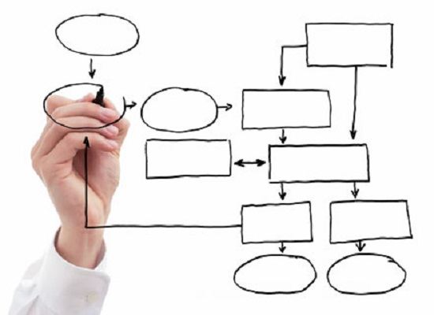


Introduction
Process Mining
Relatively young and developing research area and main idea is to
discover,
monitor and;
improve processes by extracting information from event logs.
[1]
Events recorded and available
Competitive business life
4
Recommendation Generation for Performance Improvement by using Cross-Organizational Process Mining

Slide 5




Introduction
Cross- Organizational Process Mining
Analyze the big picture
Work together to execute the same process
Cloud computing and shared infrastructures
Event logs of multiple organizations
Learn from each other
[2]
Execute the same task on shared infrastructure
[3]
5
Recommendation Generation for Performance Improvement by using Cross-Organizational Process Mining

Slide 6

Introduction
Focus of this Study
A hybrid approach
Using different process mining subfields to create a new point of view
Cross-organizational process mining
Processes are executed on several organizations,
Unsupervised learning using performances of organizations
6
Recommendation Generation for Performance Improvement by using Cross-Organizational Process Mining

Slide 7
Agenda
1
Introduction
5
Results & Discussions
2
Related Work
6
Conclusion & Future Work
3
Background
7
Demonstration
4
Methodology
7
Recommendation Generation for Performance Improvement by using Cross-Organizational Process Mining

Slide 8
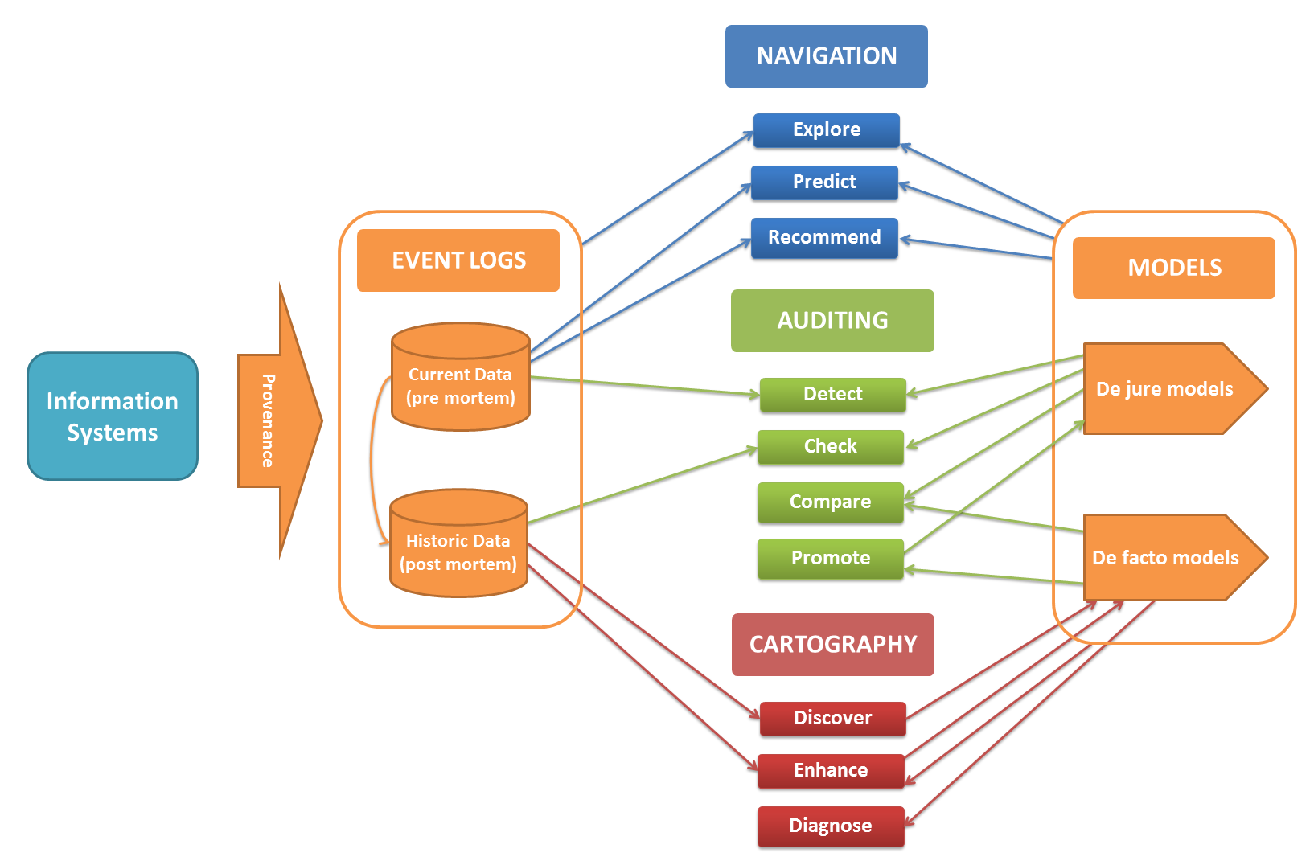
Related Work
State of the Art in Process Mining
[4]
8
Recommendation Generation for Performance Improvement by using Cross-Organizational Process Mining

Slide 9
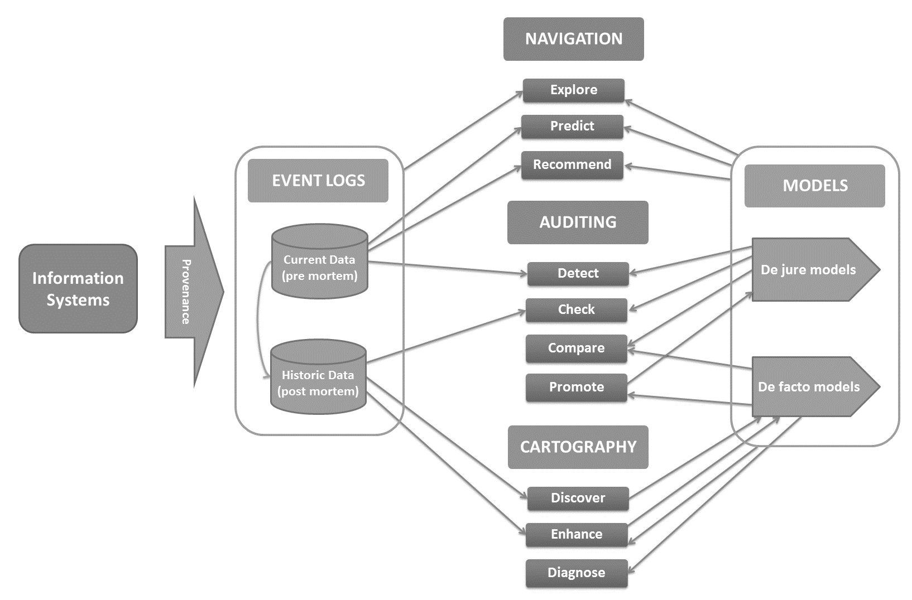
Related Work
State of the Art in Process Mining
Discover maps using the discovery techniques
Promotes the partially best locations in the map
Create recommendations for travelers in their navigation applications
Recommendation Generation for Performance Improvement by using Cross-Organizational Process Mining
9

Slide 10

Related Work
Process Discovery in Process Mining
Various different process mining algorithms for solving different challenges in the process mining area
Alpha Algorithm
Inductive Approach
Hierarchical Clustering
Genetic Approach
Heuristic Approach
[5] [6]
Robust, repeatable and mature set of approaches
[7] [8]
[9]
[10] [11]
[12]
10
Recommendation Generation for Performance Improvement by using Cross-Organizational Process Mining

Slide 11

Related Work
Cross-organizational Process Mining
Analyze processes of organizations in an objective manner
Matching behaviors and process models of organizations
Configurable process models for organizations
Intra and inter-organizational process mining:
Collaboration
Exploiting commonality
[2]
[13]
[3]
Learning opportunity of organizations from each other
11
Recommendation Generation for Performance Improvement by using Cross-Organizational Process Mining

Slide 12

Related Work
Process Similarity in Process Mining
Emerging attention in business processes
Repository of process models of similar business operations
Methods in the literature
Similarity Metrics
Alignment Matrix
Delta Analysis
Mismatch Patterns
[2]
[14]
[15]
Point the pattern differences between organizations
[16]
[17] [18]
[14]
12
Recommendation Generation for Performance Improvement by using Cross-Organizational Process Mining

Slide 13

Related Work
Contributions of This Study
Cross-organizational process mining approach for process performance improvement
Generic, noise-capable process mining method for mining process models of different organizations
Clustering of organizations based on their performance indicators
Unlike the clustering methods based on process structures in the literature
[9]
Recommendation Generation for Performance Improvement by using Cross-Organizational Process Mining
13

Slide 14

Related Work
Contributions of This Study
Mismatch analysis for spotting differences between processes of organizations
Formulation and implementation of patterns and analyzers
Recommendation generation to show how organizations can learn from other organizations which perform better
Open-source, extensible and configurable set of plugins in ProM framework
Recommendation Generation for Performance Improvement by using Cross-Organizational Process Mining
14

Slide 15
Agenda
1
Introduction
5
Results & Discussions
2
Related Work
6
Conclusion & Future Work
3
Background
7
Demonstration
4
Methodology
Recommendation Generation for Performance Improvement by using Cross-Organizational Process Mining
15

Slide 16

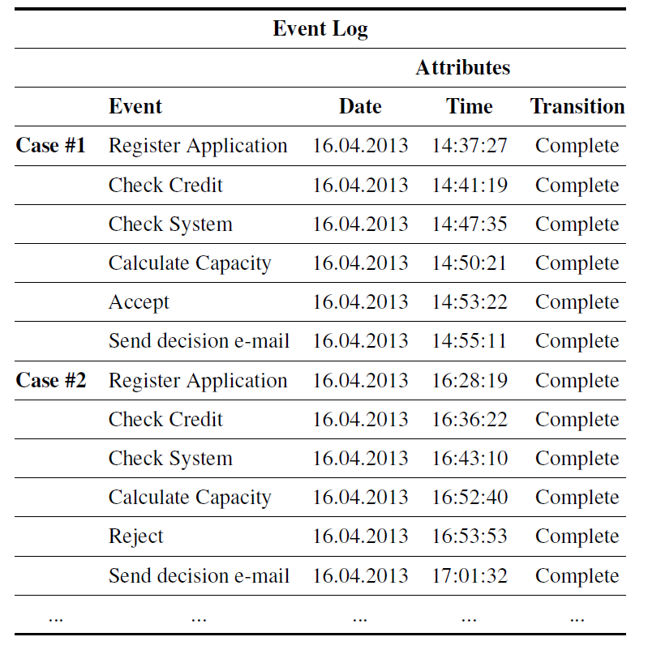
Background
Event Log
Outputs of the software systems like Enterprise Resource Planning (ERP) or Business Process Management (BPM)
Recommendation Generation for Performance Improvement by using Cross-Organizational Process Mining
16

Slide 17
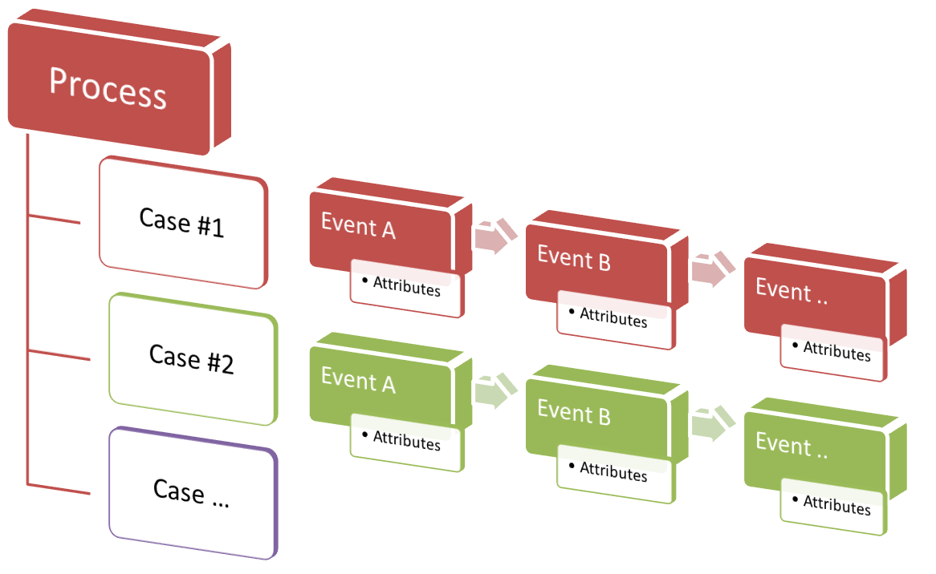
Background
Event Log
17
Recommendation Generation for Performance Improvement by using Cross-Organizational Process Mining

Slide 18
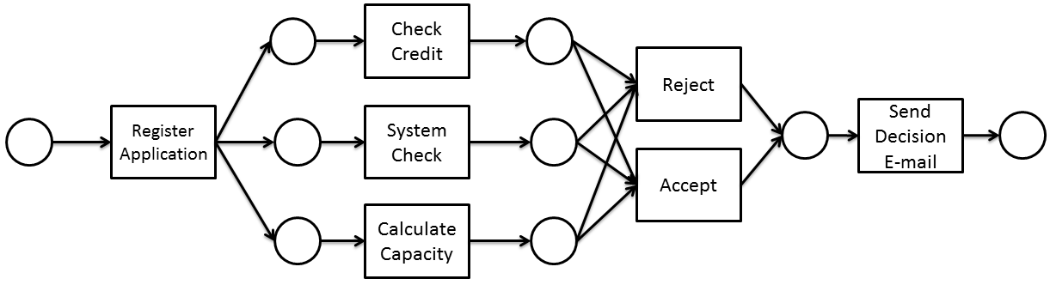
Background
Process Modeling
Workflow Net
Petri net with a start node, end node and connectedness
Mathematical background
Recommendation Generation for Performance Improvement by using Cross-Organizational Process Mining
18

Slide 19
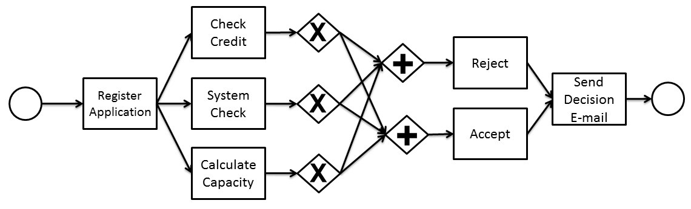
Background
Process Modeling
Business Process Modelling Notation (BPMN)
Standardized and easy to understand by stakeholders
Business oriented
Recommendation Generation for Performance Improvement by using Cross-Organizational Process Mining
19

Slide 20

Background
Process Discovery
One of the most challenging tasks is to construct a process model based on the behavior in the event logs
Inductive Process Mining is used since it is simple, highly applicable and configurable
Block-structured Workflow Nets
Rediscoverability
[19]
Recommendation Generation for Performance Improvement by using Cross-Organizational Process Mining
20

Slide 21
Background
Process Discovery
Inductive Miner Infrequent (IMi) is proposed as an extension to Inductive Miner to handle noise in the event logs:
Activity Sets: Split the activities in log to disjoint sets.
Sublogs: Split the log by using activity sets.
Recursive Mining: Mine sublogs with these steps until a sublog contains only single activity.
[20]
Filter infrequent behavior at every step by a user defined threshold
Recommendation Generation for Performance Improvement by using Cross-Organizational Process Mining
21

Slide 22


Background
Process Performance Analysis
Discover relationships between event logs and process models for conformance and performance analysis
[21]
Move event log
Distance Function
Alignment
Move process model
Optimal Alignment
Recommendation Generation for Performance Improvement by using Cross-Organizational Process Mining
22

Slide 23
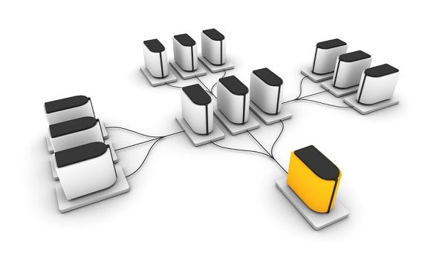

Background
Clustering
k-means algorithm (Lloyd’s algorithm) and its variation based on random initialization:
k-means++ by Arthur and Vassilvitskii
Clustering of performance analysis results of organizations
Implementation of k-means++ in WEKA
[22]
[23]
23
Recommendation Generation for Performance Improvement by using Cross-Organizational Process Mining

Slide 24




Background
Mismatch Patterns in Process Models
Patterns for frequent mismatches between the similar process models by Dijkman
[14]
Authorization
Activity
Control Flow
Skipped Activity
Refined Activity
Activities at Different Moments in Processes
Different Conditions for Occurrence
Different Dependencies
Additional Dependencies
24
Recommendation Generation for Performance Improvement by using Cross-Organizational Process Mining

Slide 25
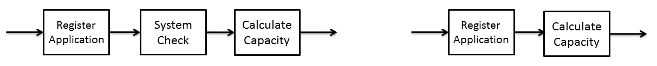
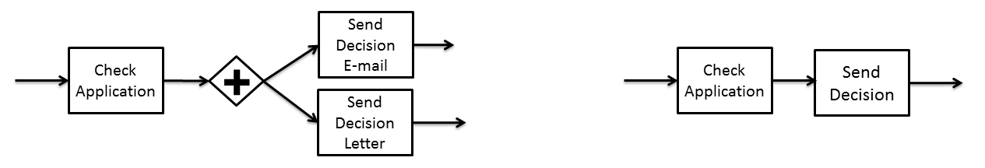
Background
Mismatch Patterns in Process Models
Activity Mismatch Patterns
[14]
Skipped Activity
Refined Activity
Recommendation Generation for Performance Improvement by using Cross-Organizational Process Mining
25

Slide 26
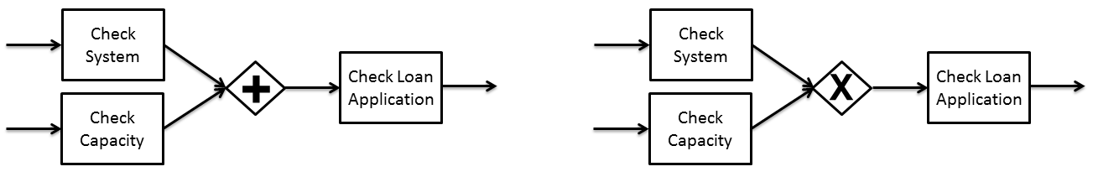
Background
Mismatch Patterns in Process Models
Control Flow Mismatch Patterns
[14]
Activities at Different Moments in Processes
Different Conditions for Occurrence
26
Recommendation Generation for Performance Improvement by using Cross-Organizational Process Mining

Slide 27
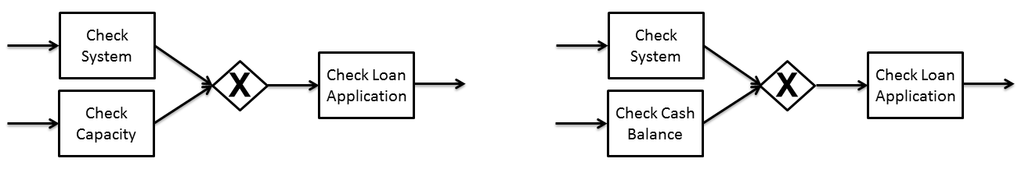
Background
Mismatch Patterns in Process Models
Control Flow Mismatch Patterns
[14]
Different Dependencies
Additional Dependencies
Recommendation Generation for Performance Improvement by using Cross-Organizational Process Mining
27

Slide 28
Agenda
1
Introduction
5
Results & Discussions
2
Related Work
6
Conclusion & Future Work
3
Background
7
Demonstration
4
Methodology
28
Recommendation Generation for Performance Improvement by using Cross-Organizational Process Mining

Slide 29
Methodology
Approach Overview
Process Model Mining
1
3
Mismatch Pattern Analysis
Process models from event logs for each organization
Differences between process models of organizations
Performance Indicator Analysis
2
4
Recommendation Generation
Replay event logs and collect performance data
Cluster organizations
Set of recommendation for each organization using the clusters and mismatch patterns
Recommendation Generation for Performance Improvement by using Cross-Organizational Process Mining
29

Slide 30
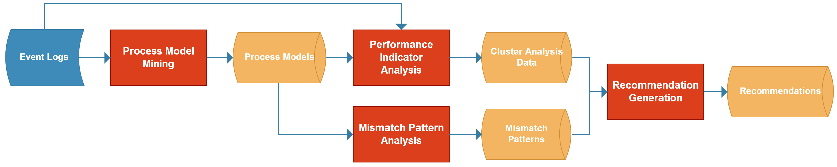
Methodology
Approach Overview
Recommendation Generation for Performance Improvement by using Cross-Organizational Process Mining
30

Slide 31
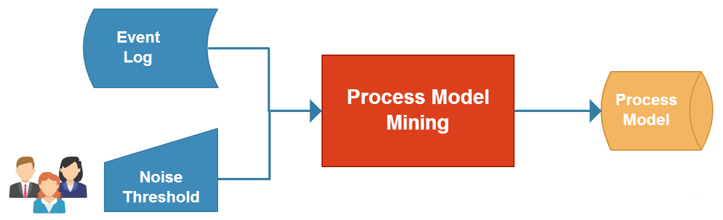
Methodology
Process Model Mining
Applied for each organization:
Using «Inductive Miner Infrequent (IMi)» method
Workflow net as process model
31
Recommendation Generation for Performance Improvement by using Cross-Organizational Process Mining

Slide 32

Methodology
Performance Indicator Analysis
Two steps:
Replay and Performance Indicator Calculation
Performance
Indicator Clustering
Performance Indicators:
Average Time Between Activities
Standard Deviation of Time Between Activities
Recommendation Generation for Performance Improvement by using Cross-Organizational Process Mining
32

Slide 33
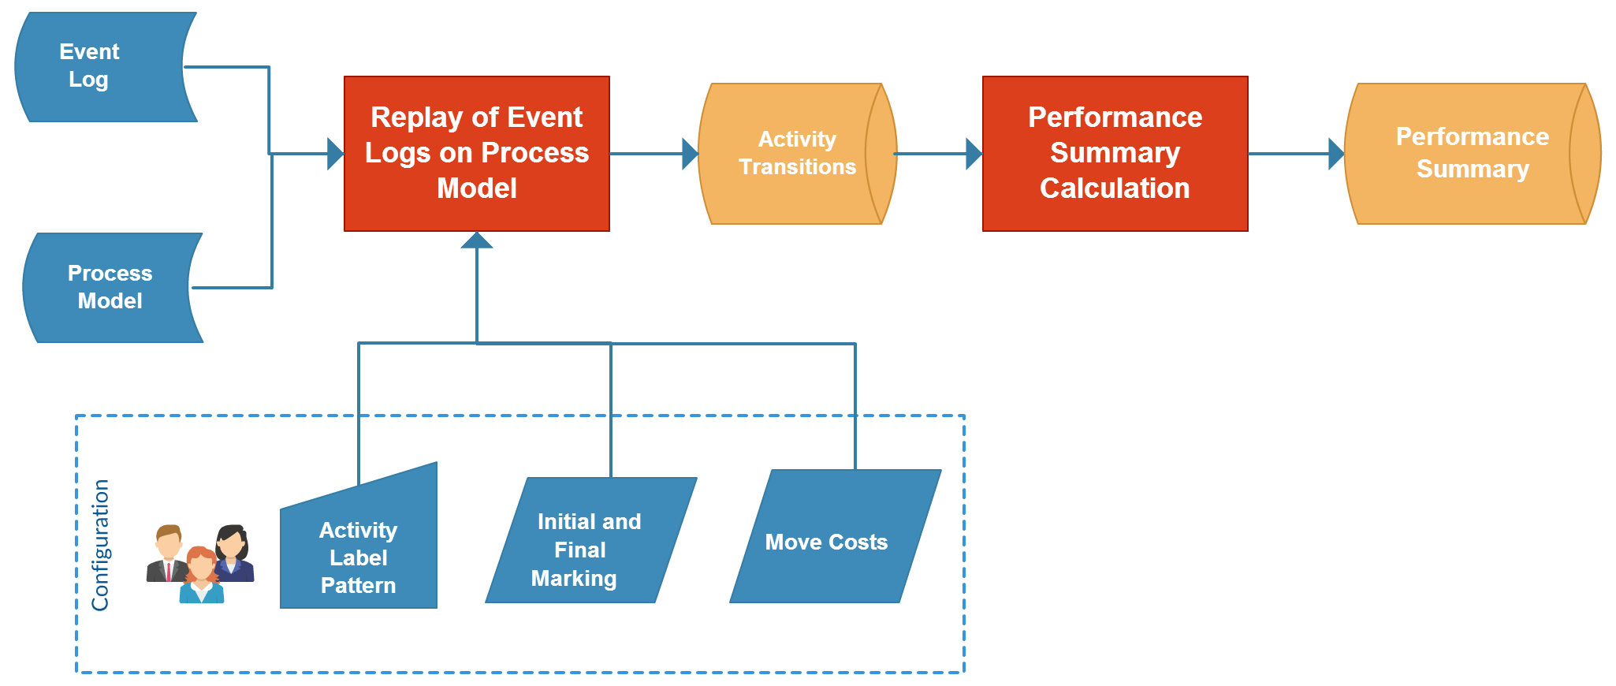
Methodology
Performance Indicator Analysis - Replay and Performance Indicator Calculation
Applied for each organization:
Recommendation Generation for Performance Improvement by using Cross-Organizational Process Mining
33

Slide 34
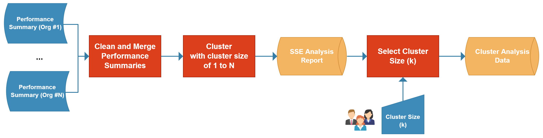
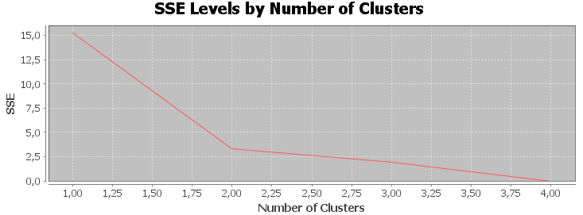
Methodology
Performance Indicator Analysis – Performance Indicator Clustering
# of Clusters
Cluster Assignment
Centroids (Performance Indicator Values for each cluster)
Recommendation Generation for Performance Improvement by using Cross-Organizational Process Mining
34

Slide 35
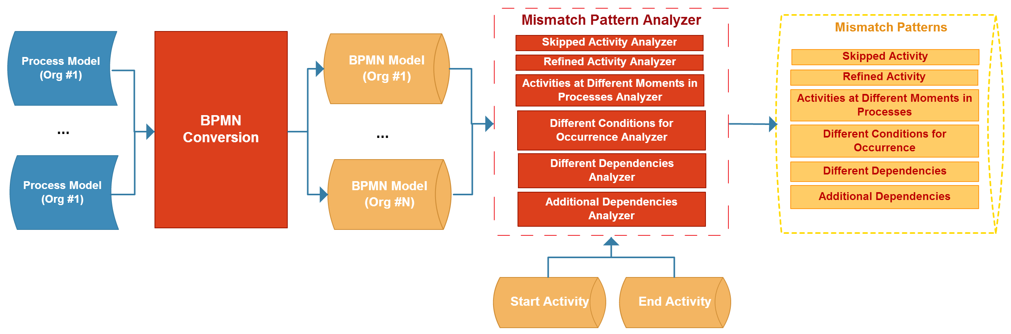
Methodology
Mismatch Pattern Analysis
Spot the differences between process models of different organizations as mismatch patterns
BPMN used since notation is more appropriate to formulate mismatch patterns
Recommendation Generation for Performance Improvement by using Cross-Organizational Process Mining
35

Slide 36
Methodology
Mismatch Pattern Analysis
Mismatch patterns and analyzers are developed
36
Recommendation Generation for Performance Improvement by using Cross-Organizational Process Mining

Slide 37
Methodology
Mismatch Pattern Analysis
Mismatch patterns and analyzers formulated
input: O₁ first organization, O₂ second organization, A_{start} starting activity, A_{end} ending activity
output: MismatchPatterns a set of mismatch patterns
MismatchPatterns <-- {}
MismatchPatterns <-- SkippedActivityAnalyzer(O_{1,} A_{start,} A_{end})
MismatchPatterns <-- RefinedActivityAnalyzer(O_{1,} O_{2,} A_{start,} A_{end})
MismatchPatterns <-- DifferentMomentsAnalyzer(O_{1,} O_{2,} A_{start,} A_{end})
MismatchPatterns <-- DifferentConditionsAnalyzer(O_{1,} O_{2,} A_{start,} A_{end})
MismatchPatterns <-- DifferentDependencysAnalyzer(O_{1,} O_{2,} A_{start,} A_{end})
MismatchPatterns <-- AdditionalDependencysAnalyzer(O_{1,} O_{2,} A_{start,} A_{end})
return MismatchPatterns
37
Recommendation Generation for Performance Improvement by using Cross-Organizational Process Mining

Slide 38

Methodology
Recommendation Generation
Providing a set of mismatch patterns for each organization to enhance their processes.
Mismatch patterns between organizations, which are performing better in terms of their performance indicator values.
Recommendation = (Organization, A_{start}, A_{end}, Mismatch Patterns)
Recommendation Generation for Performance Improvement by using Cross-Organizational Process Mining
38

Slide 39
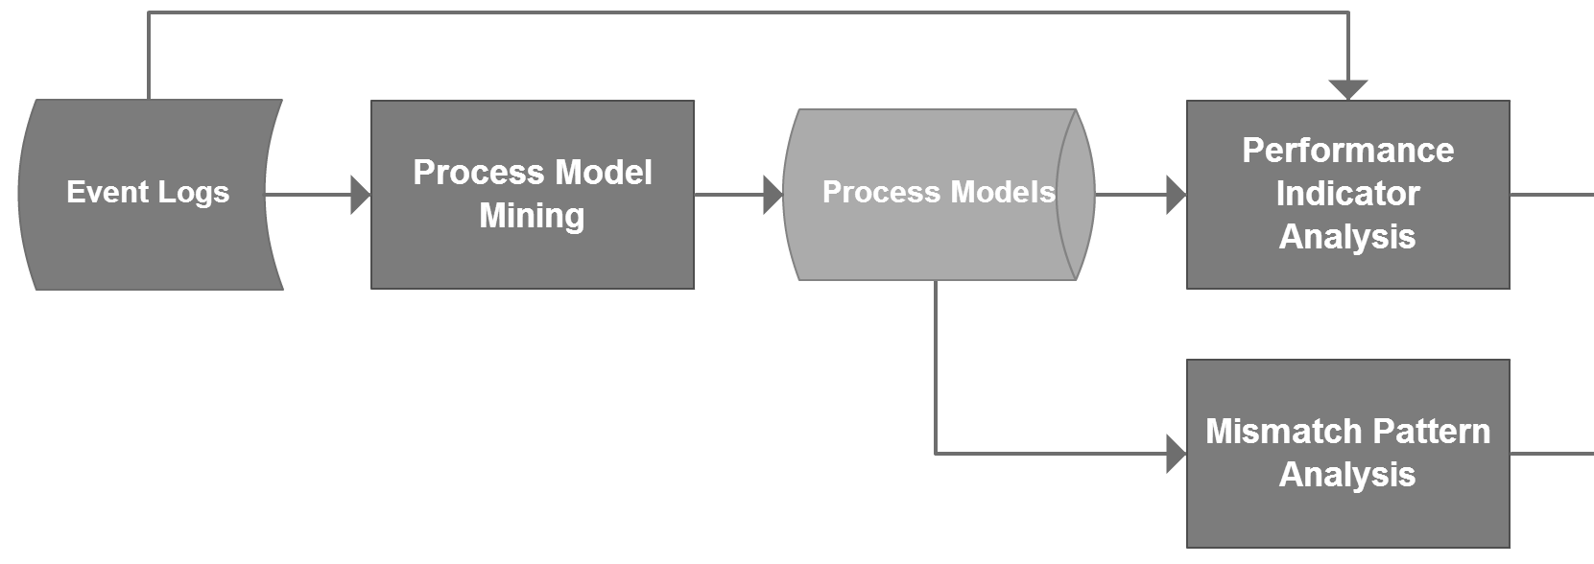
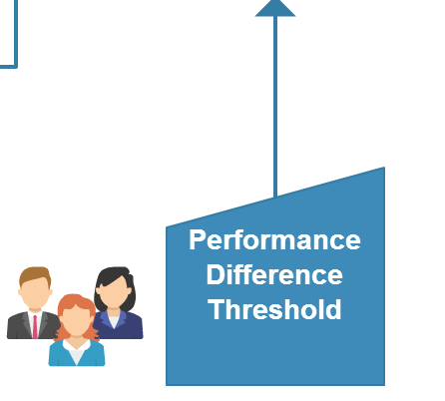
Methodology
Recommendation Generation
Calculated over the same type of performance indicators of different
organizations
Recommendation Generation for Performance Improvement by using Cross-Organizational Process Mining
39

Slide 40
Methodology
Recommendation Generation
RecommendationGeneration
input: O organization, C Cluster Analysis Data, P performance difference threshold
output: Recommendations a set of recommendations
Recommendations ← {}
i ← Cluster of organization O
for each centroid for cluster i
Get other cluster j with the centroids of A_{start} and A_{end}; and
value difference larger than P
for each organization O’ in the cluster j
MismatchPatterns ← Mismatch Pattern Analysis(O, O',A_{start}, A_{end})
Recommendations ← Recommendation(O, A_{start},A_{end}, MismatchPatterns)
40
Recommendation Generation for Performance Improvement by using Cross-Organizational Process Mining

Slide 41
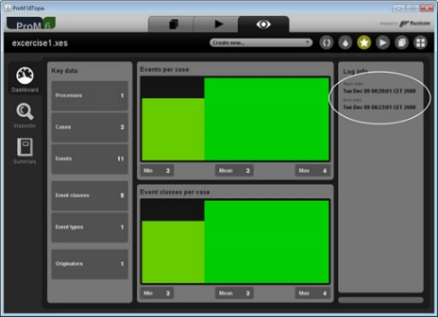

Methodology
ProM Implementation
ProM, extensible framework that supports a wide variety of process mining techniques in form of plugins
Widely accepted in industry and academia with an active community
Developed set of plugins are packaged with the name of «CrossOrgProcMin» and published on Github.
[24]
onuryilmaz/cross-orc-proc-min
41
Recommendation Generation for Performance Improvement by using Cross-Organizational Process Mining

Slide 42
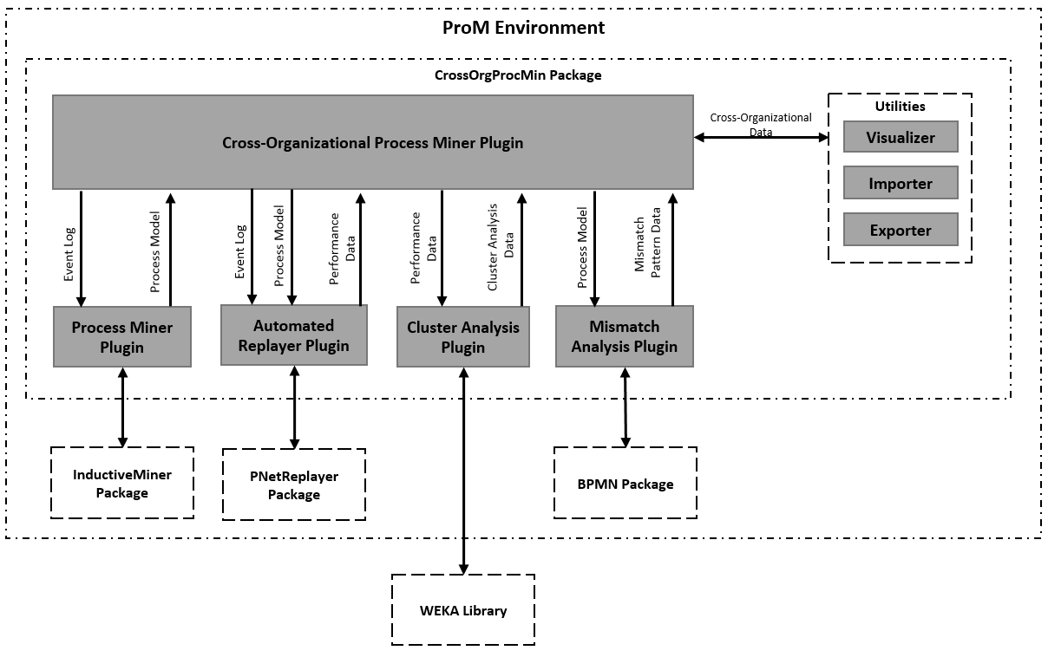
Methodology
ProM Implementation
Recommendation Generation for Performance Improvement by using Cross-Organizational Process Mining
42

Slide 43
Agenda
1
Introduction
5
Results & Discussions
2
Related Work
6
Conclusion & Future Work
3
Background
7
Demonstration
4
Methodology
Recommendation Generation for Performance Improvement by using Cross-Organizational Process Mining
43

Slide 44
Results & Discussions
Evaluation Metrics
Process Model Mining
1
3
Mismatch Pattern Analysis
[25]
Fitness
Appropriateness
Structural Appropriateness
Behavioral Appropriateness
Graph-edit distance similarity vs. # of Mismatch Patterns
[25]
[15]
Performance Indicator Analysis
2
4
Recommendation Generation
[21]
Alignment costs for replay
Within-SSE values for clustering
Responsiveness with different threshold values
Comparison with and without performance clustering
Recommendation Generation for Performance Improvement by using Cross-Organizational Process Mining
44

Slide 45

Results & Discussions
Dataset Selection
Loan Application Process
Synthetically generated
4 variants of a simple loan application in a financial institute
Environmental Permit Application Process
Real-life event log from "Configurable Services for Local Governments (CoSeLoG)" project
«Environmental Permit Application Process» of 5 municipalities in Netherlands
[26]
[27]
[13]
45
Recommendation Generation for Performance Improvement by using Cross-Organizational Process Mining

Slide 46
Results & Discussions
Loan Application Process
 | Cases | Events | Percentage
Variant #1 | 100 | 590 | 24 %
Variant #2 | 70 | 420 | 17 %
Variant #3 | 200 | 800 | 33 %
Variant #4 | 105 | 630 | 26 %
Cases
Events
475
2440
These variants are used as organizational logs
46
Recommendation Generation for Performance Improvement by using Cross-Organizational Process Mining

Slide 47
Results & Discussions
Loan Application Process – Process Model Mining
With «0» noise threshold
 | Fitness | Structural Appropriateness | Behavioral Appropriateness | Average Appropriateness
Variant #1 | 100 % | 70 % | 98.5 % | 84.2 %
Variant #2 | 100 % | 100 % | 100 % | 100 %
Variant #3 | 100 % | 100 % | 100 % | 100 %
Variant #4 | 100 % | 100 % | 98.2 % | 99.1 %
Average | 100 % | 92.5 % | 99.7 % | 96.6 %
Each process model is fitting to event log and «appropriate»
47
Recommendation Generation for Performance Improvement by using Cross-Organizational Process Mining

Slide 48
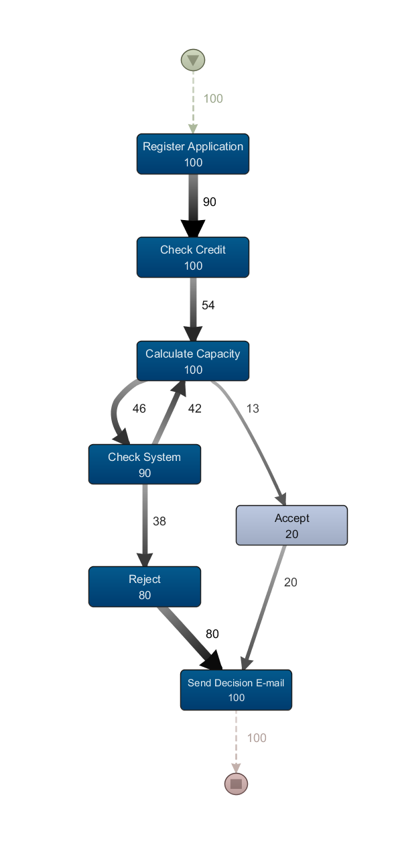
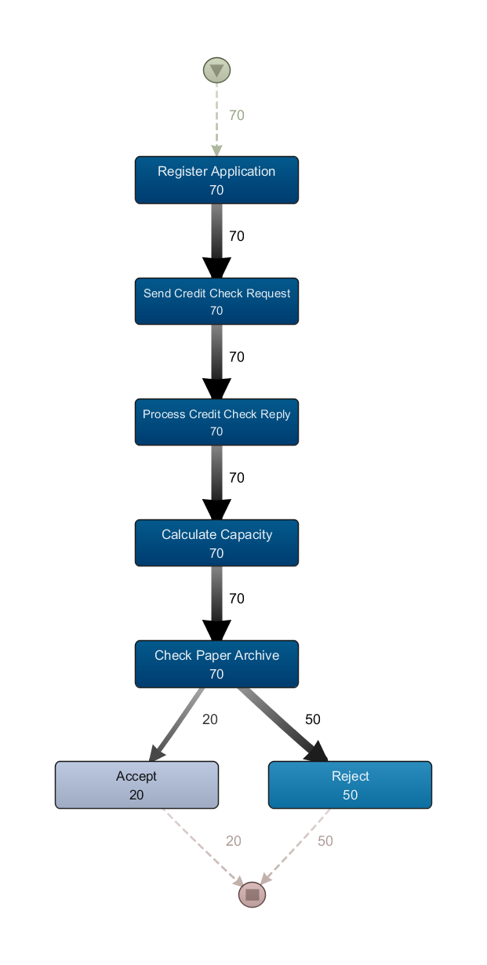
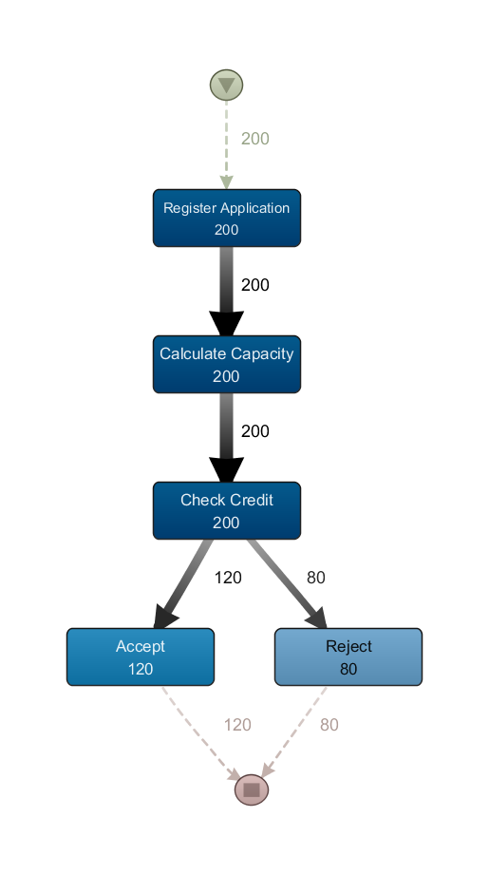
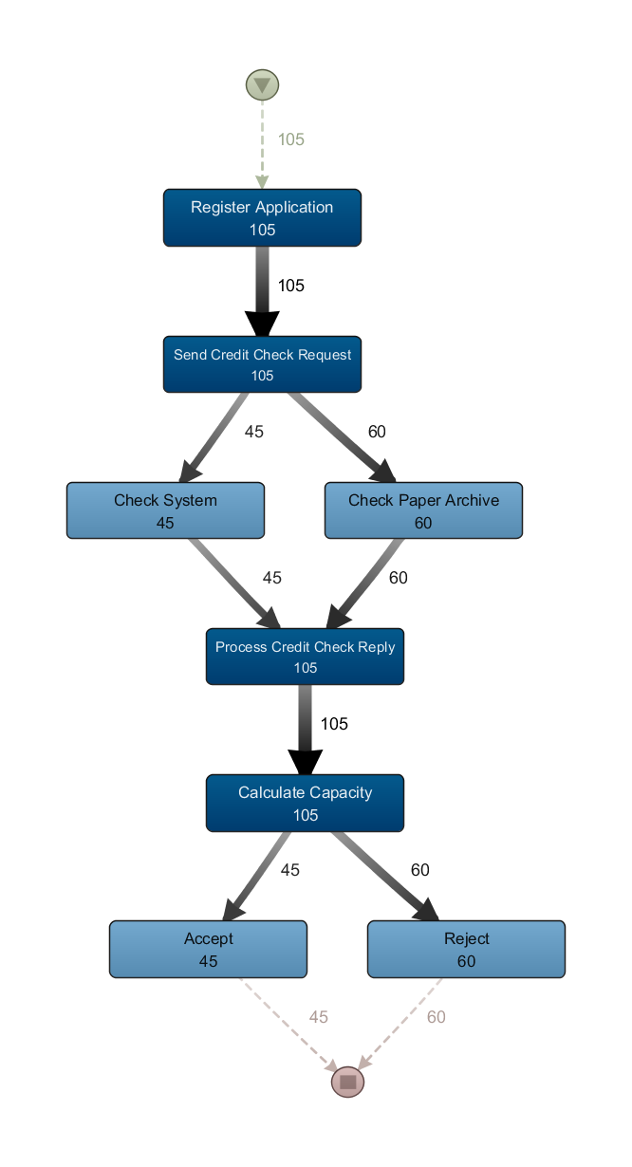
Results & Discussions
Loan Application Process – Process Model Mining
Variant #1
Variant #2
Variant #3
Variant #4
48
Recommendation Generation for Performance Improvement by using Cross-Organizational Process Mining

Slide 49
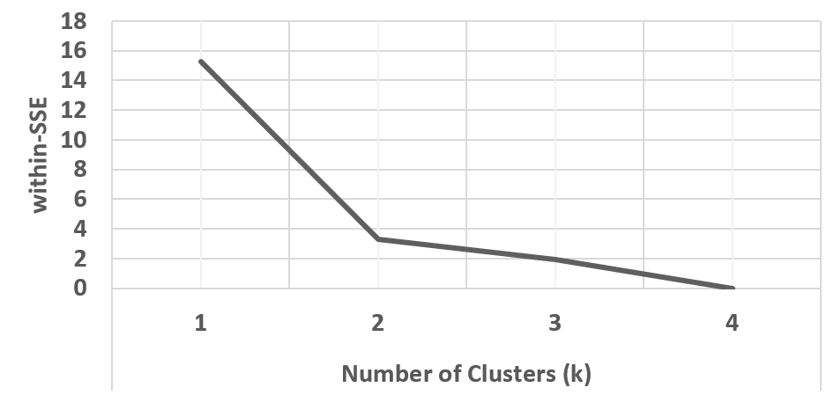
Results & Discussions
Loan Application Process – Performance Indicator Analysis
Performance Indicator Calculation:
Replay costs are all zero since 100 % fitness is achieved
Clustering:
Cluster #2
Variant #1 #2 #4
Variant #3
Cluster #1
49
Recommendation Generation for Performance Improvement by using Cross-Organizational Process Mining

Slide 50
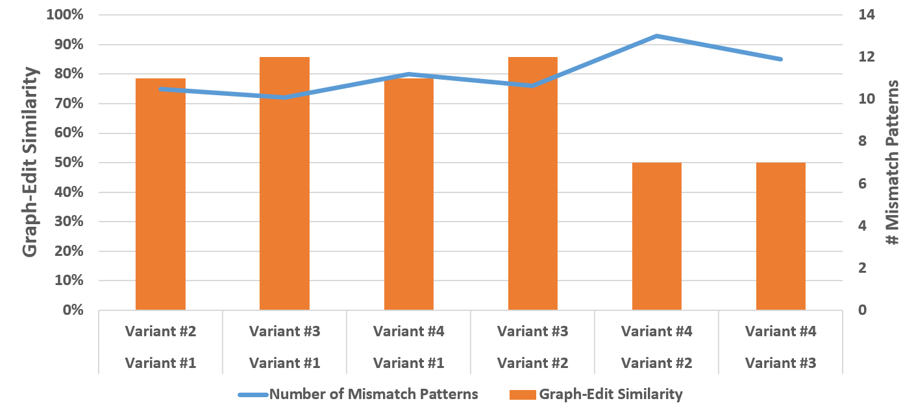
Results & Discussions
Loan Application Process – Mismatch Pattern Analysis
Correlation between graph-edit similarity and number of mismatch patterns
50
Recommendation Generation for Performance Improvement by using Cross-Organizational Process Mining

Slide 51
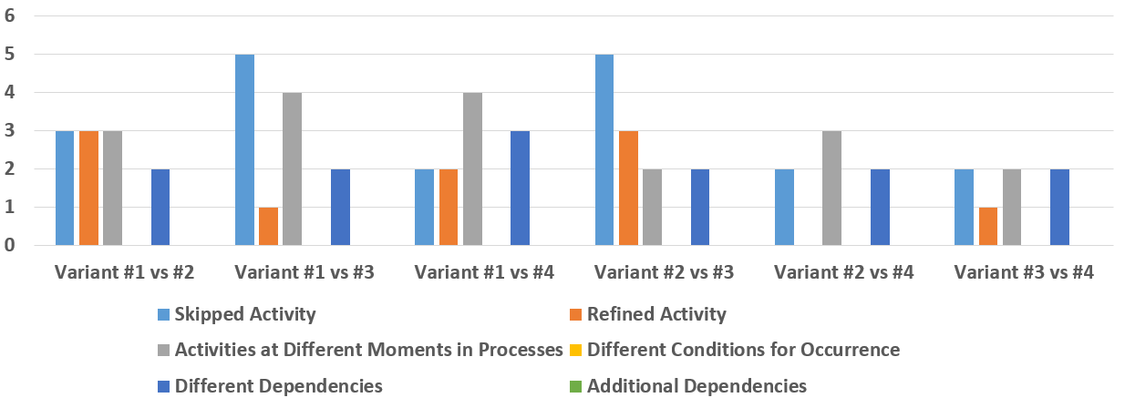
Results & Discussions
Loan Application Process – Mismatch Pattern Analysis
"Skipped Activity" and "Activities at Different Moments" mostly
No "Different Conditions for Occurrence" or "Additional Dependencies"
51
Recommendation Generation for Performance Improvement by using Cross-Organizational Process Mining

Slide 52
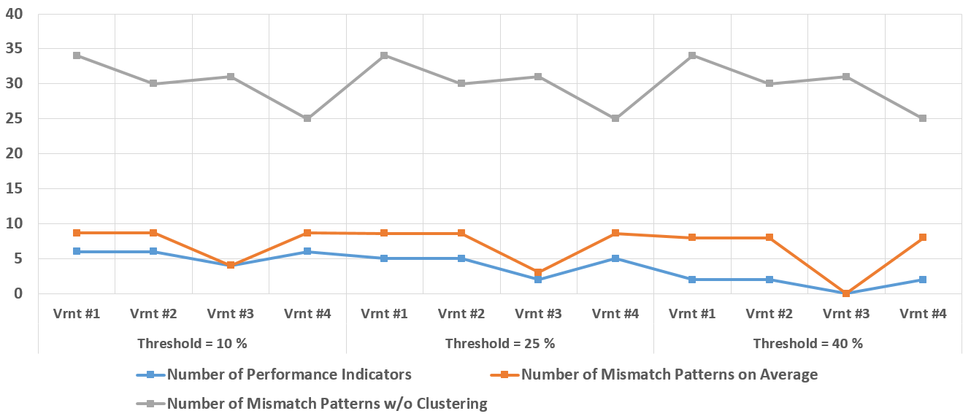
Results & Discussions
Loan Application Process – Recommendation Generation
Responsiveness and degree of helping the user to focus on the performance improvement
52
Recommendation Generation for Performance Improvement by using Cross-Organizational Process Mining

Slide 53
Results & Discussions
Environmental Permit Application Process
 | Cases | Events | Percentage
Municipality #1 | 54 | 131 | 6.1 %
Municipality #2 | 302 | 586 | 27.3 %
Municipality #3 | 37 | 73 | 3.4 %
Municipality #4 | 340 | 507 | 23.7 %
Municipality #5 | 481 | 845 | 39.4 %
Cases
Events
1214
2142
Preprocessing is undertaken on the raw dataset
These municipalities are used as organizational logs
[28]
53
Recommendation Generation for Performance Improvement by using Cross-Organizational Process Mining

Slide 54
Results & Discussions
Environmental Permit Application Process – Process Model Mining
With 10 % noise threshold
 | Fitness | Structural Appropriateness | Behavioral Appropriateness | Average Appropriateness
Municipality #1 | 86 % | 97.5 % | 54.4 % | 76 %
Municipality #2 | 100 % | 100 % | 100 % | 100 %
Municipality #3 | 92.3 % | 71.1 % | 67.2 % | 69.1 %
Municipality #4 | 96.8 % | 65.7 % | 64 % | 64.9 %
Municipality #5 | 94.5 % | 58.8 % | 39.7 % | 49.3 %
Average | 93.9 % | 78.6 % | 65.1 % | 71.9 %
High fitness values except Municipality #4 and #5
54
Recommendation Generation for Performance Improvement by using Cross-Organizational Process Mining

Slide 55
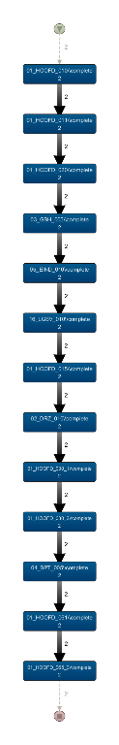
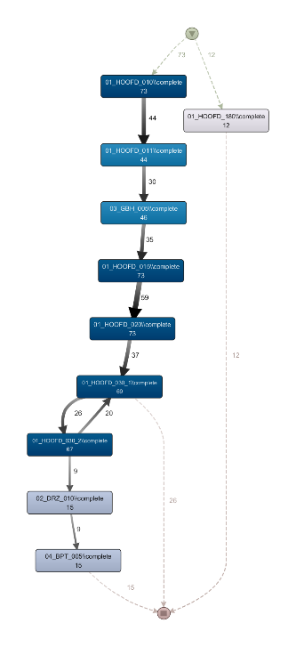
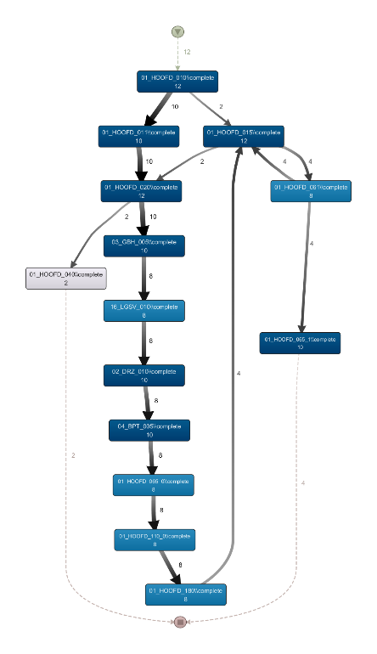
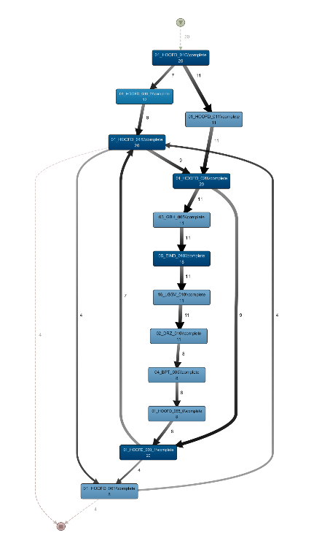
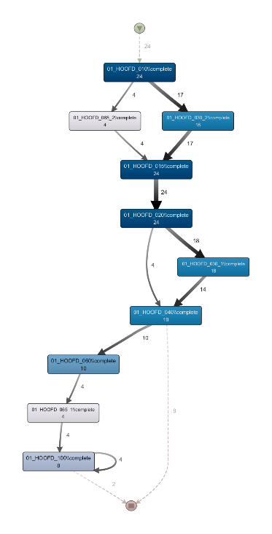
Results & Discussions
Environmental Permit Application Process – Process Model Mining
10 to 20 times simplified process models
Municipality #1
Municipality #2
Municipality #3
Municipality #4
Municipality #5
55
Recommendation Generation for Performance Improvement by using Cross-Organizational Process Mining

Slide 56
Results & Discussions
Environmental Permit Application Process – Performance Indicator Analysis
Performance Indicator Calculation:
As appropriateness and fitness decrease; alignment costs increase for the municipalities
Performance indicators calculated over replay are acceptable
 | Fitness | Average Appropriateness | Alignment Cost
Municipality #1 | 86 % | 76 % | 173.2
Municipality #2 | 100 % | 100 % | 0
Municipality #3 | 92.3 % | 69.1 % | 323.3
Municipality #4 | 96.8 % | 64.9 % | 9.1
Municipality #5 | 94.5 % | 49.3 % | 35.8
56
Recommendation Generation for Performance Improvement by using Cross-Organizational Process Mining

Slide 57
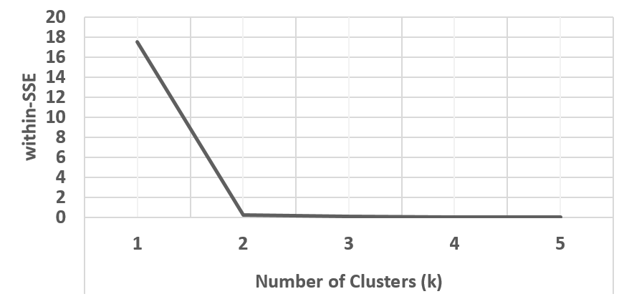
Results & Discussions
Environmental Permit Application Process – Performance Indicator Analysis
Clustering:
Cluster #2
Municipality #1
Municipality #2 #3 #4 #5
Cluster #1
Cluster #2
Municipality #1
Municipality #2 #4
Municipality #3 #5
Cluster #1
Cluster #3
57
Recommendation Generation for Performance Improvement by using Cross-Organizational Process Mining

Slide 58
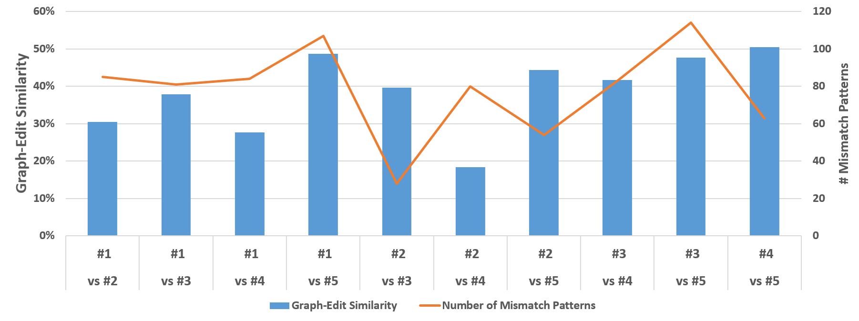
Results & Discussions
Environmental Permit Application Process – Mismatch Pattern Analysis
Correlation between graph-edit similarity and number of mismatch patterns except Municipality #4 and #5
58
Recommendation Generation for Performance Improvement by using Cross-Organizational Process Mining

Slide 59
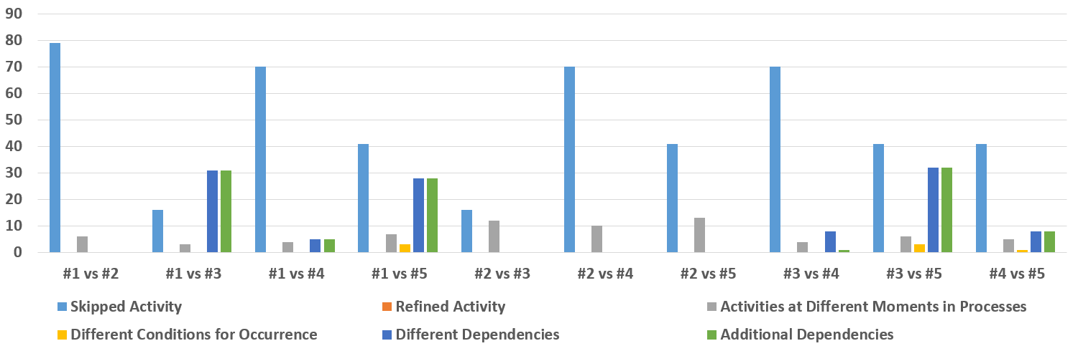
Results & Discussions
Environmental Permit Application Process – Mismatch Pattern Analysis
"Skipped Activity" mostly
"Refined Activity" is eliminated since codes are used instead of activity names
59
Recommendation Generation for Performance Improvement by using Cross-Organizational Process Mining

Slide 60
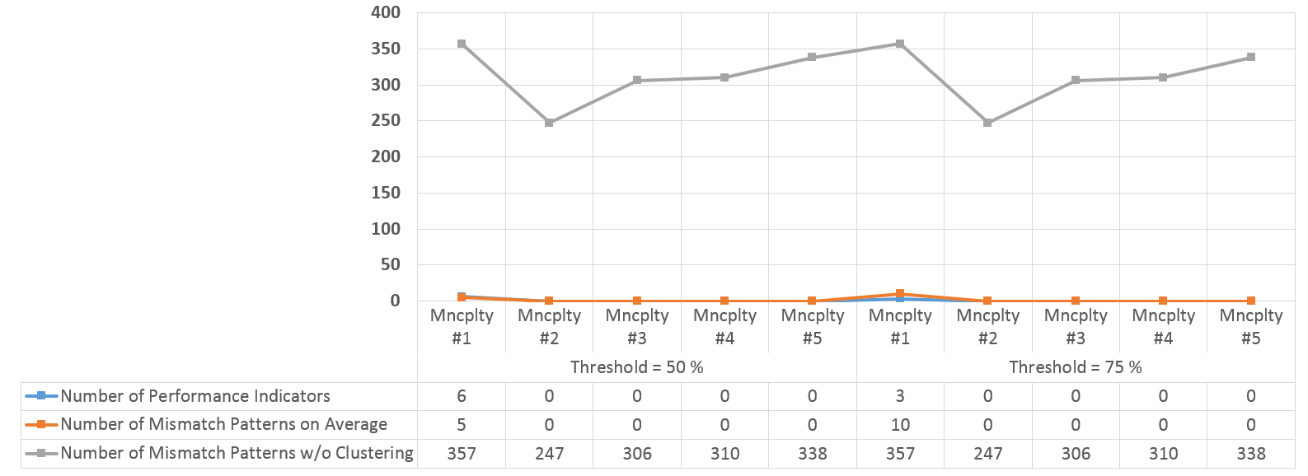
Results & Discussions
Environmental Permit Application Process – Recommendation Generation
(with 2 clusters)
Number of mismatch patterns to check significantly decreases with performance clustering
60
Recommendation Generation for Performance Improvement by using Cross-Organizational Process Mining

Slide 61
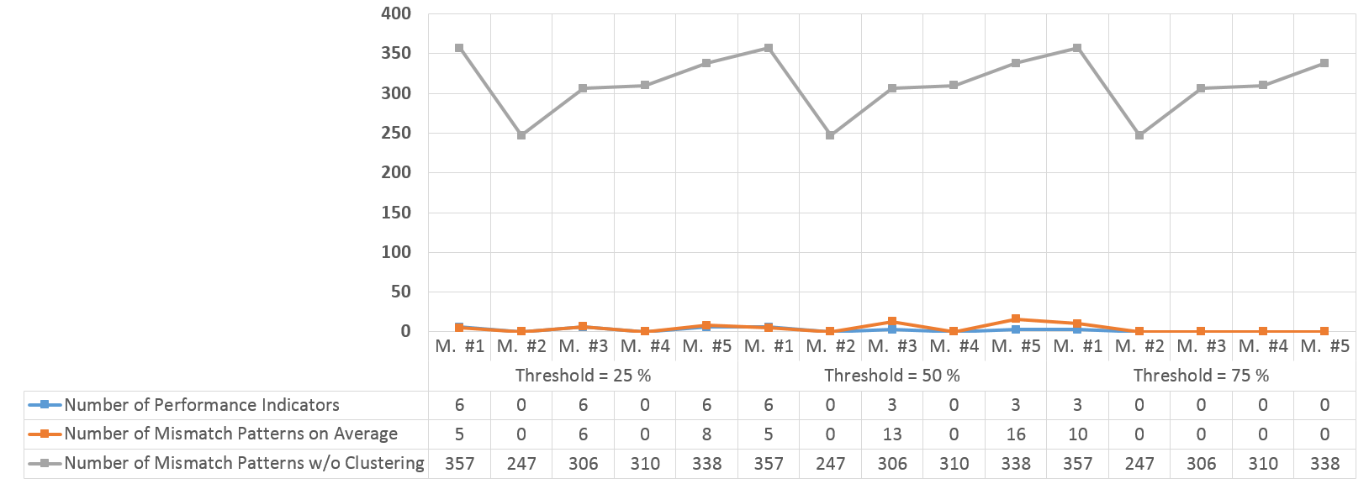
Results & Discussions
Environmental Permit Application Process – Recommendation Generation
(with 3 clusters)
Learning opportunities increases as number of cluster increases
Number of mismatch patterns to check significantly decreases with performance clustering
61
Recommendation Generation for Performance Improvement by using Cross-Organizational Process Mining

Slide 62

Results & Discussions
Discussions
Process mining stage:
Mines the process models with high fitness and high appropriateness from event logs
Performance indicator calculation stage:
With the high quality process models, calculated performance indicators are acceptable
Clustering stage:
Organizations can be clustered based on their performance indicators
62
Recommendation Generation for Performance Improvement by using Cross-Organizational Process Mining

Slide 63
Results & Discussions
Discussions
Mismatch analysis stage:
It finds differences in accordance with similarity metrics
Not all mismatch patterns are discovered
Information value of mismatch patterns are not equal
Recommendation generation stage:
Performance clustering helps to focus on differences
3 times more in Loan Application Process
100 times more in Environmental Permit Application Process
63
Recommendation Generation for Performance Improvement by using Cross-Organizational Process Mining

Slide 64
Results & Discussions
Discussions
Business value of generated recommendations:
Results may be
important or
infeasible and irrelevant for business environment
Some insights about results can be provided but business environment and case related assessment is also required.
64
Recommendation Generation for Performance Improvement by using Cross-Organizational Process Mining

Slide 65
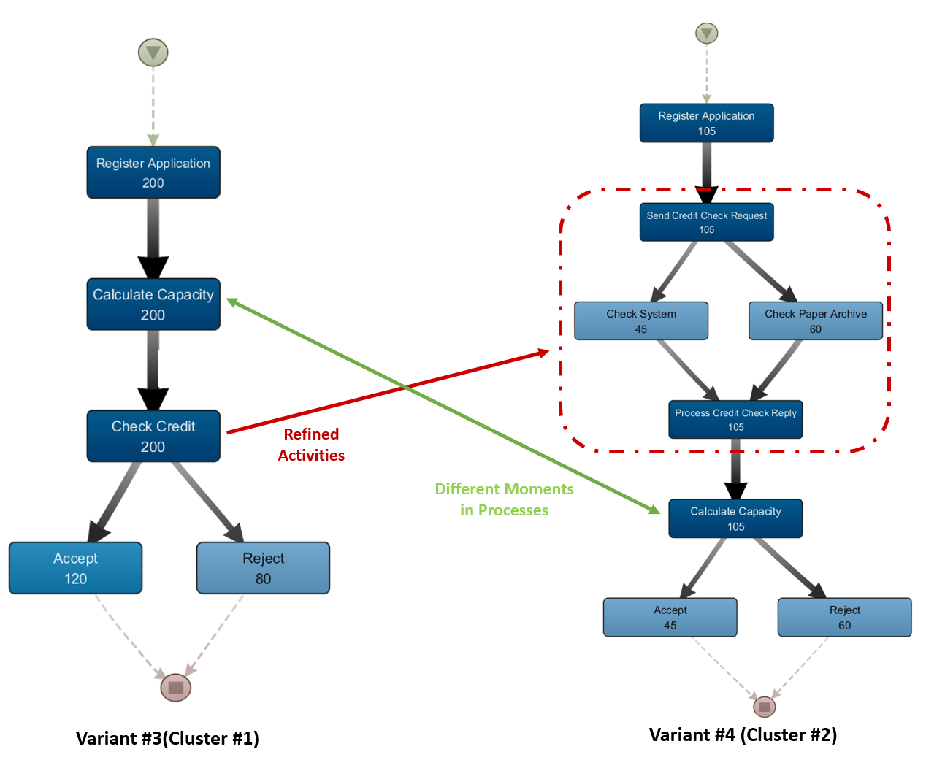
Results & Discussions
Discussions
In Loan Application Process, Variant #3 performs worse
27 % on average time and
12 % on standard deviation time
between activities
Calculate Capacity» → Accept
65
Recommendation Generation for Performance Improvement by using Cross-Organizational Process Mining

Slide 66
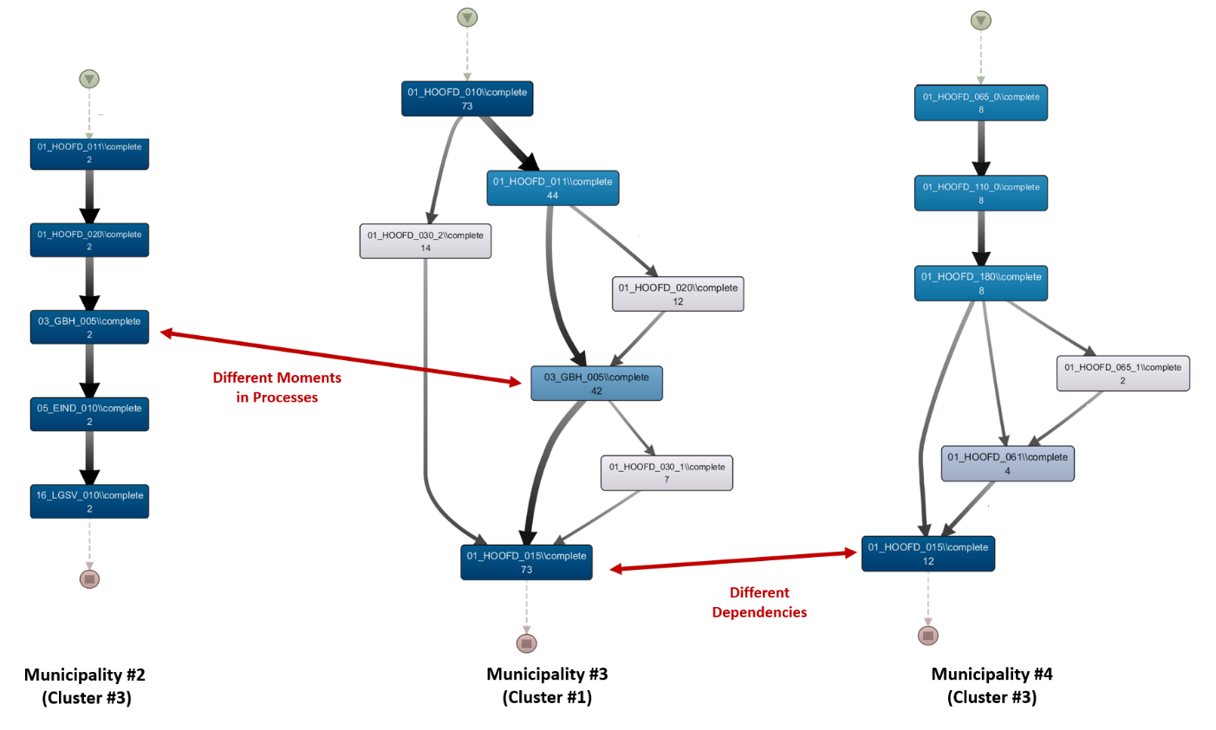
Results & Discussions
Discussions
In Environmental Permit Application Process, Cluster #3 performs better
40 % on average time and
53% on standard deviation time
between activities
01_HOOFD_010 → 01_HOOFD_015
66
Recommendation Generation for Performance Improvement by using Cross-Organizational Process Mining

Slide 67
Agenda
1
Introduction
5
Results & Discussions
2
Related Work
6
Conclusion & Future Work
3
Background
7
Demonstration
4
Methodology
Recommendation Generation for Performance Improvement by using Cross-Organizational Process Mining
67

Slide 68

Conclusion
Cross-organizational process mining is applied
Unsupervised learning with predictor variables as performances of organizations
In an environment where processes are executed on several organizations
Results show that it is possible to use cross-organizational process mining and mismatch patterns for performance improvement recommendations
Recommendation Generation for Performance Improvement by using Cross-Organizational Process Mining
68

Slide 69
Conclusion
A four-stage solution is presented and their performances are explained
Process Model Mining
1
3
Mismatch Pattern Analysis
Performance Indicator Analysis
2
4
Recommendation Generation
Recommendation Generation for Performance Improvement by using Cross-Organizational Process Mining
69

Slide 70

Conclusion
Future Work
Process mining stage:
Different techniques can be used to mine complex process models
Performance indicator stage:
New indicators based on business environment
Mismatch pattern analysis:
New patterns can be introduced
Recommendation Generation for Performance Improvement by using Cross-Organizational Process Mining
70

Slide 71
Conclusion
Future Work
Recommendation generation:
Domain or BPM expertise to assess the quality of recommendations
ProM implementation:
Visually selecting the interested area of process models
Recommendation Generation for Performance Improvement by using Cross-Organizational Process Mining
71

Slide 72
Agenda
1
Introduction
5
Results & Discussions
2
Related Work
6
Conclusion & Future Work
3
Background
7
Demonstration
4
Methodology
72
Recommendation Generation for Performance Improvement by using Cross-Organizational Process Mining

Slide 73


Demonstration
Also available on YouTube
https://youtu.be/T92UrRfl3r0
Recommendation Generation for Performance Improvement by using Cross-Organizational Process Mining
73

Slide 74
References
1] W. M. P. van der Aalst, A. Adriansyah, A.K.A. de Medeiros, and et al. Process mining
manifesto. In Business process management workshops, pages 169–194. Springer, 2012.
[2] J. C. Buijs, B. F. van Dongen, and W. M. P. van der Aalst. Towards crossorganizational process mining in collections of process models and their executions. In Business Process Management Workshops, pages 2–13. Springer, 2012.
[3] W. M. P. van der Aalst. Intra-and inter-organizational process mining: Discovering processes within and between organizations. In The Practice of Enterprise Modeling, pages 1–11. Springer, 2011.
[4] W. M. P. van der Aalst. Process mining: discovery, conformance and enhancement of business processes. Springer Science & Business Media, 2011.
[5] A. K. A. de Medeiros, B. F. van Dongen,W. M. P. van der Aalst, and A. J. M. M. Weijters. Process mining: Extending the -algorithm to mine short loops. 2004.
[6] W. M. P. van der Aalst, T.Weijters, and L. Maruster. Workflow mining: Discovering process models from event logs. Knowledge and Data Engineering, IEEE Transactions on, 16(9):1128–1142, 2004.
[7] J. Herbst. Dealing with concurrency in workflow induction. In European Concurrent Engineering Conference. SCS Europe. Citeseer, 2000.
74
Recommendation Generation for Performance Improvement by using Cross-Organizational Process Mining

Slide 75
References
[8] J. Herbst and D. Karagiannis. Integrating machine learning and workflow management to support acquisition and adaptation of workflow models. In Database and Expert Systems Applications, 1998. Proceedings. Ninth International Workshop on, pages 745–752. IEEE, 1998.
[9] G. Greco, A. Guzzo, and L. Pontieri. Mining hierarchies of models: From abstract views to concrete specifications. In Business Process Management, pages 32–47. Springer, 2005.
[10] W. M. P. van der Aalst, A.K.A. de Medeiros, and A. J. M. M. Weijters. Genetic process mining. In Applications and theory of Petri nets 2005, pages 48–69. Springer, 2005.
[11] E. Esgin, P. Senkul, and C. Cimenbicer. A hybrid approach for process mining: using from-to chart arranged by genetic algorithms. In Hybrid Artificial Intelligence Systems, pages 178–186. Springer, 2010.
[12] E. Esgin and R. Senkul. A hybrid approach to process mining: Finding immediate successors of a process by using from-to chart. In Machine Learning and Applications, 2009. ICMLA’09. International Conference on, pages 664–668. IEEE, 2009.
[13] W. M. P. van der Aalst. Business process configuration in the cloud: how to support and analyze multi-tenant processes? In Web Services (ECOWS), 2011 Ninth IEEE European Conference on, pages 3–10. IEEE, 2011.
75
Recommendation Generation for Performance Improvement by using Cross-Organizational Process Mining

Slide 76
References
[14] R. Dijkman. Mismatch Patterns in Similar Business Processes. Beta, Research School for Operations Management and Logistics, 2007.
[15] R. Dijkman, M. Dumas, B. van Dongen, R. Käärik, and J. Mendling. Similarity of business process models: Metrics and evaluation. Information Systems, 36(2):498–516, 2011.
[16] J. C. Buijs and H. A. Reijers. Comparing business process variants using models and event logs. In Enterprise, Business-Process and Information Systems Modeling, pages 154–168. Springer, 2014.
[17] E. Esgin and P. Karagoz. Sequence alignment adaptation for process diagnostics and delta analysis. In Hybrid Artificial Intelligent Systems, pages 191–201. Springer, 2013.
[18] E. Esgin and P. Senkul. Delta analysis: a hybrid quantitative approach for measuring discrepancies between business process models. In Hybrid Artificial Intelligent Systems, pages 296–304. Springer, 2011.
[19] S. J. J. Leemans, D. Fahland, and W. M. P. van der Aalst. Discovering blockstructured process models from event logs-a constructive approach. In Application and Theory of Petri Nets and Concurrency, pages 311–329. Springer, 2013.
[20] S. J. J. Leemans, D. Fahland, and W. M. P. van der Aalst. Discovering block-structured process models from event logs containing infrequent behaviour. In Business Process Management Workshops, pages 66–78. Springer, 2014.
76
Recommendation Generation for Performance Improvement by using Cross-Organizational Process Mining

Slide 77
References
[21] W. M. P. van der Aalst, A. Adriansyah, and B. van Dongen. Replaying history on process models for conformance checking and performance analysis. Wiley Interdisciplinary Reviews: Data Mining and Knowledge Discovery, 2(2):182–192, 2012.
[22] D. Arthur and S. Vassilvitskii. k-means++: the advantages of carefull seeding. In Proceedings of the eighteenth annual ACM-SIAM symposium on Discrete algorithms, pages 1027–1035, 2007.
[23] M. Hall, E. Frank, G. Holmes, B. Pfahringer, P. Reutemann, and I. H. Witten. The weka data mining software: An update. SIGKDD Explor. Newsl., 11(1):10–18, November 2009.
[24] H. M. W. Verbeek, J. C Buijs, B. F. van Dongen, and W. M. P. van der Aalst. Prom 6: The process mining toolkit. Proc. of BPM Demonstration Track, 615:34–39, 2010.
[25] A. Rozinat and W. M. P. van der Aalst. Conformance checking of processes based on monitoring real behavior. Information Systems, 33(1):64–95, 2008.
[26] J. C. Buijs. Loan application example, 2013.
[27] J.C. Buijs. Environmental permit application process (‘wabo’), coselog project, 2014.
[28] J. C. Buijs. Flexible Evolutionary Algorithms for Mining Structured Process Models. PhD thesis, PhD thesis. Eindhoven, The Netherlands: Technische Universiteit Eindhoven, 2014 (cit. on p. 179), 2014.
77
Recommendation Generation for Performance Improvement by using Cross-Organizational Process Mining

Slide 78

Questions & Comments
Thank you for your attention!
Recommendation Generation for Performance Improvement by using Cross-Organizational Process Mining
78

Slide 79
Recommendation Generation for Performance Improvement by using Cross-Organizational Process Mining
Onur Yılmaz
Supervisor: Assoc. Prof. Pınar Karagöz
September 1, 2015
Middle East Technical University, Computer Engineering Department

